Slide 1
Robox Team
New Work
Methodologies
By Gil Kedar
RoBoX DiViSiOn

Slide 2
O V E R V I E W
Motive and goals
Production & QA teams
New methodologies
Testing environments
Git management
Two Months from now…

Slide 3
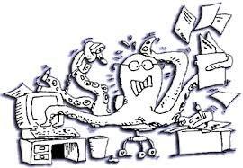
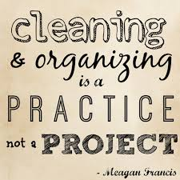
Motive and goals
Motives…
Every developer works independently, with no time frame, thus hard to manage and create a balanced improved version.
Projects are not strictly defined, causing many changes back and forth along the way due to conflicts
master branch is always unstable due to random commits, merges, version difference, and neglect of testing
Assignments frequently change due to necessity or upcoming demos, causing many context-switches that increase confusion and reduce productivity

Slide 4

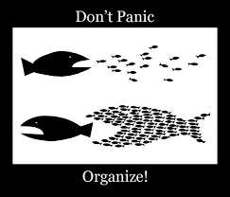
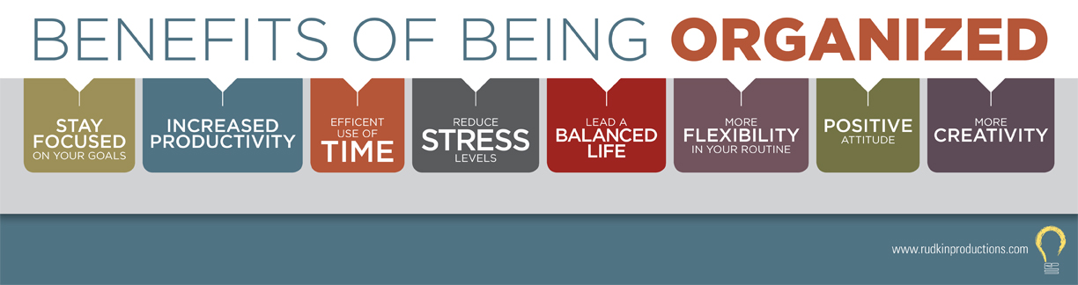
Motive and goals
Goals…
Establish order and control over projects by prioritizing and planning ahead.
React to market/product necessities quickly without quick instant patches
Reconnect the whole team to all projects, acquire new ideas and improvement tips on a weekly base
Create a proper, consistent and stable development process that will only improve over time, increasing effectiveness and productivity

Slide 5
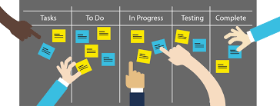
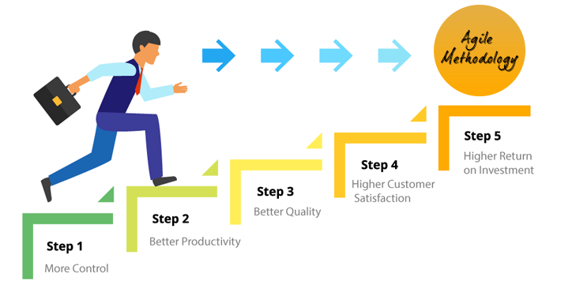
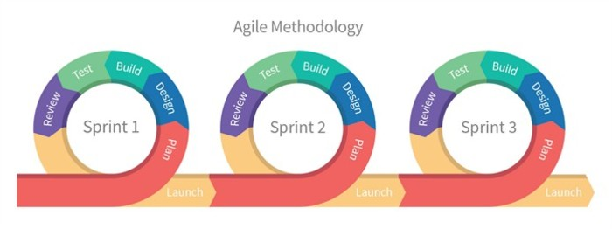
New Methodologies
Agile Development
One week sprints
Proper initial design of projects. Create smaller and testable units, and define desired behavior , under a predefined time period.
Each developer will receive specific tasks per current sprint, and will need to design and define what needs to be done.
Every developer is responsible to test their own code, and get approval of QA&CodeReview before declaring the task as done
At the end of the sprint, each developer will talk during the weekly meeting, and present
What is done
What is left to do
Raise warning flags for future development and suggest improvement tips
After we all merge together, code is sent to production team , who will conduct a full bug/errors/feature report per current version, and release a well documented version

Slide 6
New Methodologies
Flow schedules
Thursday – Meeting (Gil & Ben) to understand android’s dependencies from us for current sprint
Thursday – Meeting ( Gil&Efi ) to characterize and plan next sprints according to Yossi’s priorities
Sunday – Robox Meeting – Discuss last and next sprint
Sunday, Monday – pre staging – only critical hot fixes will be merged to master.
Monday evening – version lock to production
Tuesday – Saturday : Production & QA staging and version lock
And loop again

Slide 7
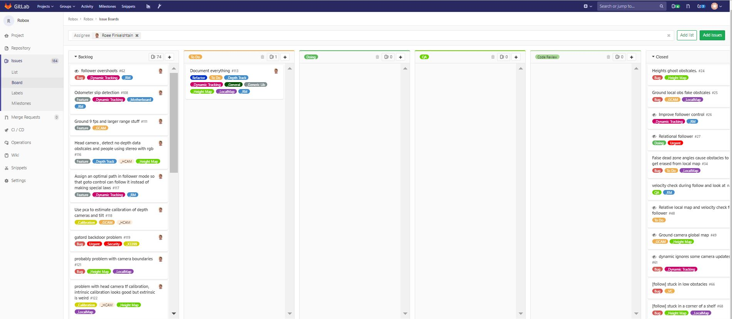
Git Managment

Slide 8
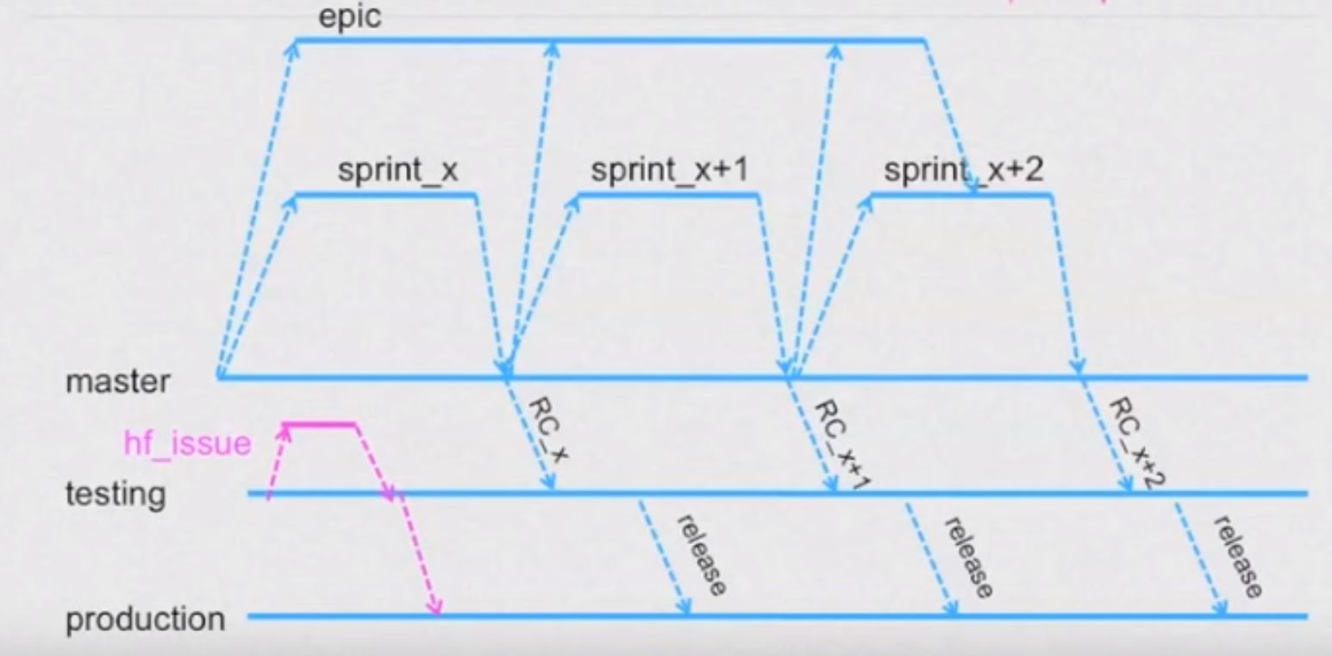
Git Managment
Unified Git conventions
Each developer will create a new branch from the master branch dedicated to assigned feature. sprintNum_projectName_featureName_issueNum_developerName sp_88_OTA_automationScript_145_aviad
When finished feature, after you tested it yourself, Move issue to QA and contact Michael, guide him to test it more intensively with all system.
After Michael’s approval, send issue to code-review, and assign your current code review buddy
After QA&CodeReview approval, create merge request and move on to the next task in the queue.
After all tasks are merged, production team will create a new testing branch from our master, and pull updates from android sprint as well. RC_sprintNum( release candidate) ,
After testing all system, merge to production branch and create a version tag.
If version is not approved, no version will be released this week, and critical failures will be pushed to current sprint.

Slide 9
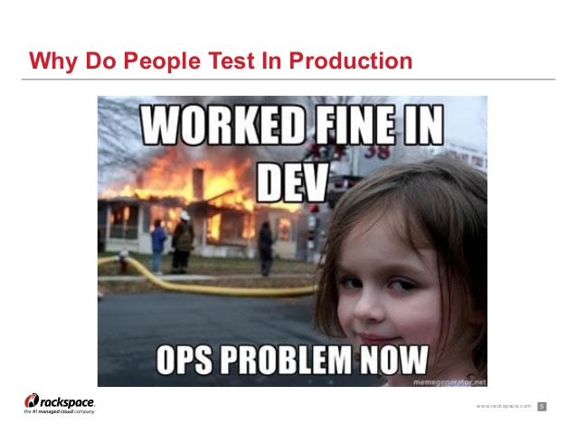
Production & QA Team
Weekly effort
Will test every related feature or task according to your instructions, and iterate with us until final approval
Test new full version from last sprint in production line. Discover, characterize and raise new issues, which will be documented and assigned according to priority queue for our next sprints
In case of critical failures and special approval, minor tasks can even enter current sprint(hot fixes).
Create a standard desired behavior and make sure no version fails that standard

Slide 10
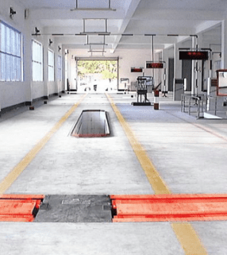
Testing environment
Production line Stations
Follow Me Path
Path Plan course (Dynamic/Static obstacles)
Map stability tests
Ground camera obstacle avoidance
ST obstacle avoidance
Various docking tests
Knowledge and void stations
Video calls sessions & Skid joy navigation
Stability & Durability tests
More Ideas???

Slide 11

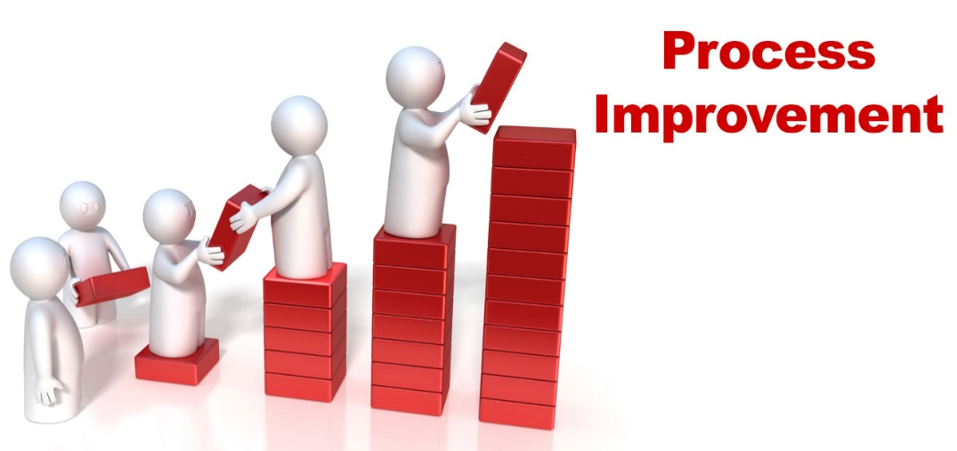

Hopefully, in Two Or Three months...
Results!!
Recruitment of Robox dedicated QA engineers, senior & junior software developers, Computer Vision expert, etc...
Steady, improving, and healthy work flow that will generate versions almost every week, and reconnect everyone to the development process
Better and faster integration with Android and other teams, since all branches must merge together.
We will solve most critical Issues ( Unacceptable and Must Have) and start working on new interesting features ( nice to have)
Gain critical experience (especially as young developers) with agile methodology and proper work flow.

Slide 12

Lets get to work !
This WeeK
Today - send master candidate to staging
Wednesday/Thursday - Continue Working on your projects
Next week- start our first sprint☺

